Slide 1
Capstone Project: Bank Churn
Devorah Finer
September 30th, 2024

Slide 2
Business Problem Definition
Problem Statement: Customer churn is a significant issue for banks, leading to decreased profitability and customer loyalty. Understanding the factors that contribute to churn can help banks develop targeted retention strategies.
Dataset: The bank churn dataset includes customer demographics, credit card usage, and transaction data from a bank.
Objective: The key objective is to analyze and predict customer churn to identify at-risk customers and take preventive measures proactively.

Slide 3
Business Value:
Reducing customer churn is a critical business problem for banks. By identifying at-risk customers, the bank can implement personalized retention strategies that reduce customer attrition and improve profitability. Additionally, better customer segmentation helps in tailoring services and improving customer satisfaction, ultimately leading to greater customer loyalty.

Slide 4
High-Level Approach to Solving the Problem
This project focuses on identifying the key factors that contribute to customer churn in a bank and building a predictive model to classify customers who are at risk of leaving. The dataset consists of customer demographics, credit card usage, and transaction data. By leveraging machine learning techniques, the goal is to accurately predict which customers are likely to churn, providing the bank with actionable insights to retain customers.

Slide 5
High-Level Approach to Solving the Problem
Data Preprocessing: Clean and handle missing data, outliers, and prepare the dataset.
Exploratory Data Analysis (EDA): Analyze patterns and trends in customer behavior.
Feature Engineering: Create and select the most relevant features for the model.
Model Development: Implement machine learning models (e.g., Logistic Regression, Random Forest, XGBoost).
Model Evaluation: Assess models using metrics like accuracy, precision, and AUC.
Visualization and Reporting: Present findings with visual aids and a summary report.

Slide 6
Data Overview
Total Rows (Samples): 10,127
Total Columns (Features): 20 after data cleaning
Nature of Dataset: Structured customer data, including demographic, account, and transaction details.
Target Variable: Attrition_Flag
Binary target variable indicating whether a customer has churned (1) or remains active (0)
Predictors: Customer_Age, Gender, Dependent_count, Education_Level, Marital_Status, Income_Category, Card_Category, Months_on_book, Total_Relationship_Count, Months_Inactive_12_mon, Contacts_Count_12_mon, Credit_Limit, Total_Trans_Amt, Total_Trans_Ct, Total_Revolving_Bal, Avg_Open_To_Buy, Total_Amt_Chng_Q4_Q1, Total_Ct_Chng_Q4_Q1, Avg_Utilization_Ratio.

Slide 7
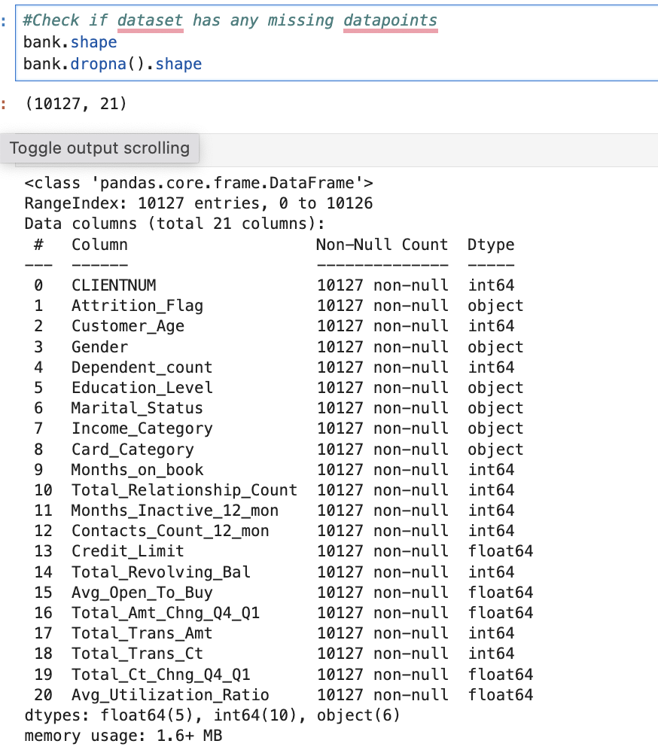
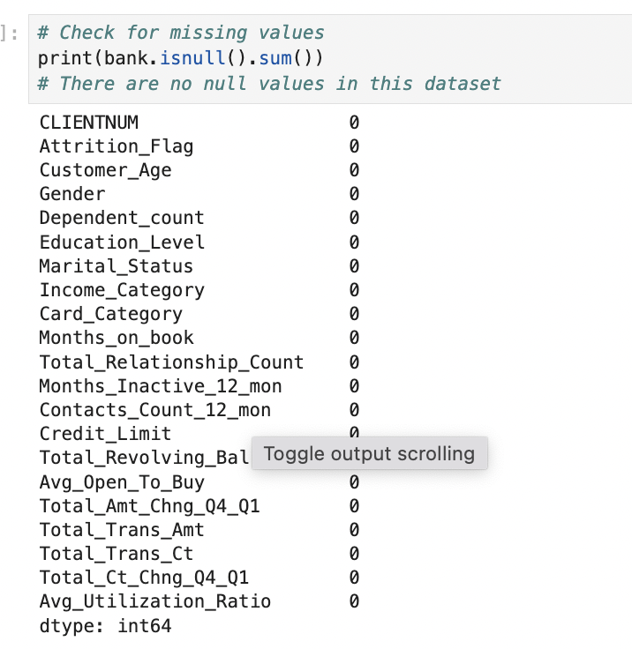
Data Overview
There is no missing data in this dataset!

Slide 8
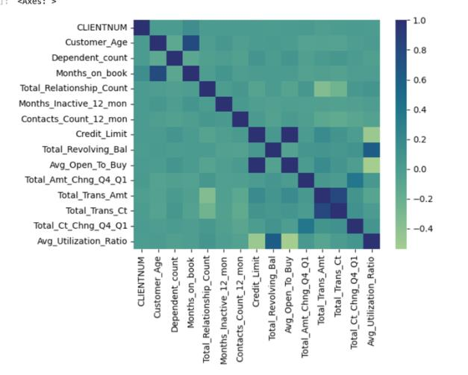
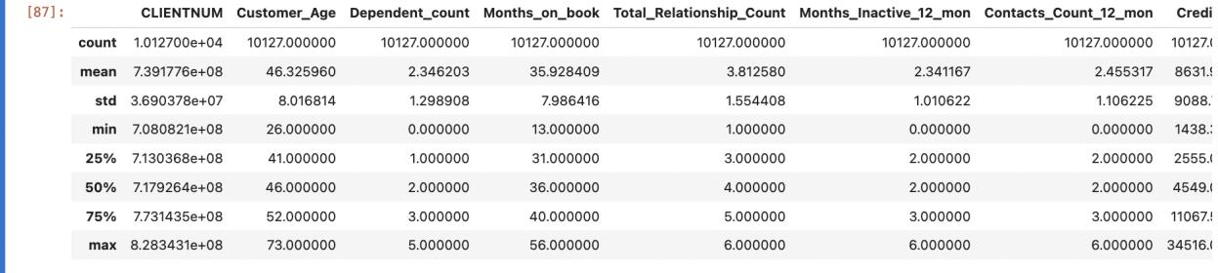
Data Overview Summary Statistics
No single feature appears to strongly correlate with the churn flag directly, suggesting that combinations of variables (e.g., income, credit utilization, and age) may play a role.

Slide 9
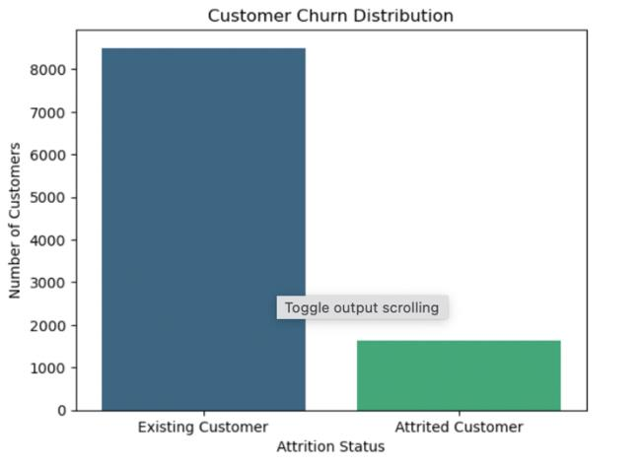
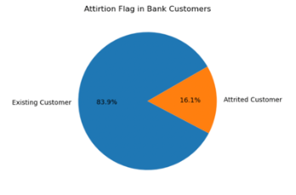
Target Variable
The target variable, Attrition_Flag, shows the distribution of churned and existing customers. Bar charts clearly show the imbalance between active and churned customers. As expected, most customers are still with the bank, with a smaller percentage having churned. This could bias the model towards predicting that most customers remain active.
• Bar Chart: Percentage of existing customers vs. churned customers
o Existing: ~85%
o Attrited: ~15%
This indicates the need to handle class imbalance carefully during model building. Oversampling or techniques like SMOTE are necessary.

Slide 10
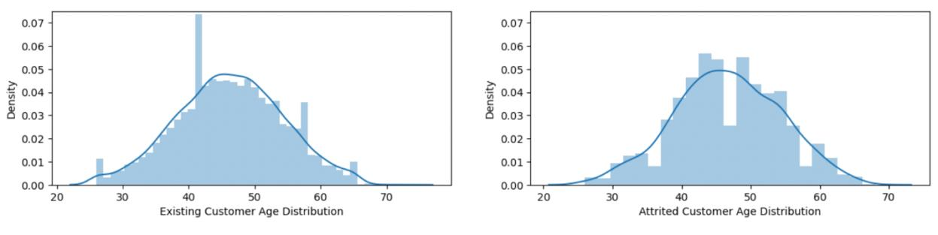
Exploratory data analysis
Age Distribution for Existing vs. Attrited Customers:
Existing customers seem to have a concentrated age group around 40-50 years.
Attrited customers show a more varied distribution but still center around 40-50 years, with noticeable outliers at higher ages.

Slide 11
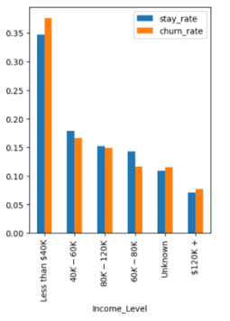
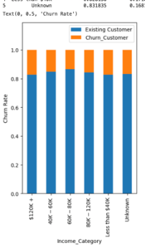
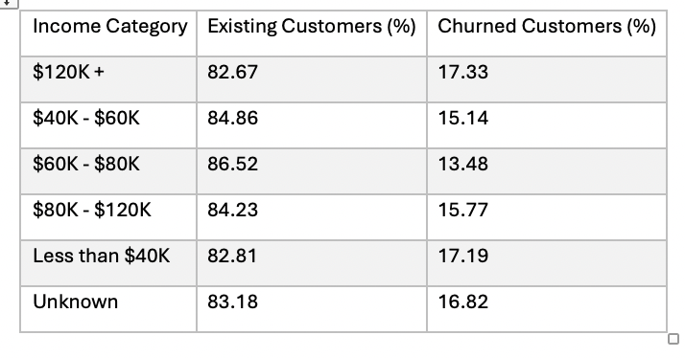
Exploratory data analysis
The analysis below examines how income level influences customer churn. Both visualizations and the data summary highlight key trends:
Distribution of Existing vs. Churned Customers: This shows that mid-range incomes retain more customers, while extremes are more prone to churn.
Highest churn rates: Seen in "$120K+" (17.33%) and "Less than $40K" (17.19%).
The lowest churn rate is in the $60K—$80K category (13.48%), suggesting better retention in mid-range incomes.
Unknown income also exhibits higher churn (16.82%). Visualization:

Slide 12
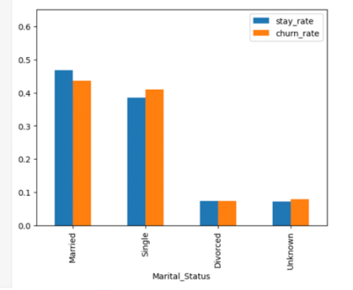
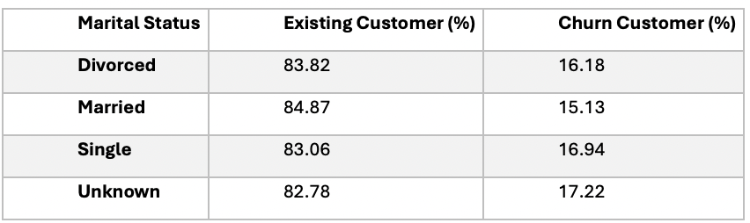
Exploratory data analysis
Marital Status and Churn Analysis
To further understand how marital status affects customer churn, a cross-tabulation of churn rates across different marital statuses was conducted:
Interpretation:
Married customers have the lowest churn rate at 15.13%, indicating a strong customer retention within this group.
Single customers display a slightly higher churn rate of 16.94%, while Divorced customers fall in between with 16.18% churn.
Unknown category has the highest churn rate at 17.22%, although the difference is marginal compared to other categories.

Slide 13
Data Preprocessing
Preprocessing was a critical part of the analysis, ensuring that the data was ready for machine learning models. The following steps were performed:
Handling Missing Values: Any missing values were identified and handled through imputation or removal.
Encoding Categorical Variables: Categorical variables such as gender and geography were transformed into numerical values using one-hot encoding.
Scaling Features: Continuous variables were scaled using the StandardScaler to ensure that features like age, balance, and income were on the same scale.
Principal Component Analysis (PCA): PCA was used for dimensionality reduction, reducing multicollinearity and improving model performance. The number of components was selected based on the explained variance, ensuring that 95% of the variance was retained.
SMOTE (Synthetic Minority Over-sampling Technique): Since the dataset exhibited class imbalance (more non-churned customers than churned ones), SMOTE was applied to generate synthetic samples for the minority class (churned customers). This technique balanced the dataset and ensured that the models were not biased toward the majority class.

Slide 14
Methodology
After preprocessing, the dataset was split into training (80%) and testing (20%) sets.
Several machine learning models were trained on the processed data, and their performance was evaluated using metrics such as accuracy, precision, recall, F1-score, and AUC (Area Under the ROC Curve). The models tested included:
Logistic Regression
Decision Tree
Random Forest
Support Vector Machine (SVM)
Naive Bayes
AdaBoost
XGBoost

Slide 15
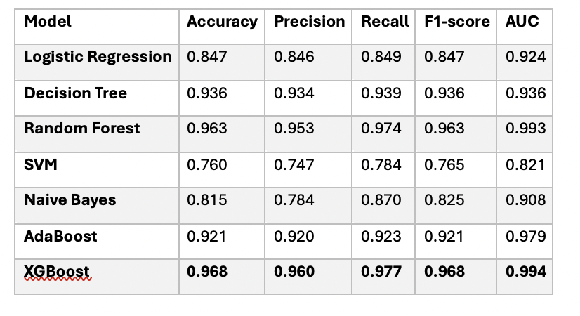
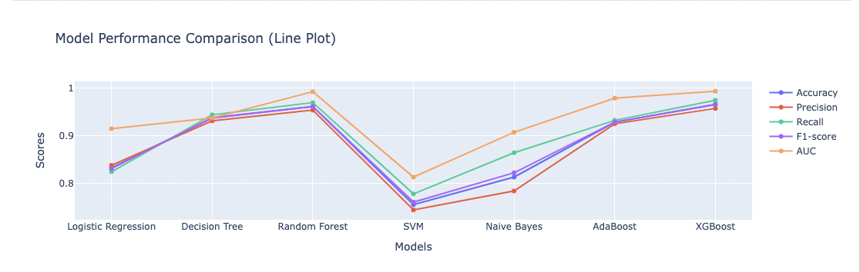
Results
Key Findings:
XGBoost performed the best overall, with an accuracy of 96.8% and an AUC of 0.994, making it the final model chosen for this analysis.
Random Forest also performed very well with an accuracy of 96.3% and the highest recall (97.4%), making it effective at identifying churned customers.
Logistic Regression and Naive Bayes were comparatively weaker in precision and recall, though their AUC values remained strong.

Slide 16
XGBoost Model
Target Variable: The target variable is Churn, indicating whether a customer has churned or remained with the bank.
Model Selected: XGBoost Classifier was chosen due to its ability to handle imbalanced datasets, high predictive accuracy, and efficiency in training.
Why Use XGBoost?
Reason for Using XGBoost: XGBoost is robust against overfitting, provides feature importance, and performs well on structured/tabular data. It also supports gradient boosting, which builds strong models from weak learners.

Slide 17
XGBoost Model
Training Dataset Size: 80% of the data was used for training the model.
Test Dataset Size: 20% of the data was reserved for testing the model.
Features: All features were scaled using StandardScaler to ensure proper convergence of the XGBoost model.
Feature Engineering:
Principal Component Analysis (PCA): PCA was applied for dimensionality reduction before training.
Oversampling: SMOTE was used to handle class imbalance in the dataset.
Final Features in the Model: All relevant features after scaling and applying PCA were used in the model.

Slide 18
Hyperparameter Tuning
Utilized GridSearchCV to optimize the XGBoost model by testing multiple combinations of hyperparameters.
Parameter Grid: Evaluated combinations of:
n_estimators: [100, 200, 300]
max_depth: [3, 4, 5]
learning_rate: [0.01, 0.1, 0.2]
subsample: [0.8, 1.0]
Cross-Validation: Used 3-fold cross-validation to assess model performance.
Scoring Metric: Optimized the model using the ROC AUC score.

Slide 19
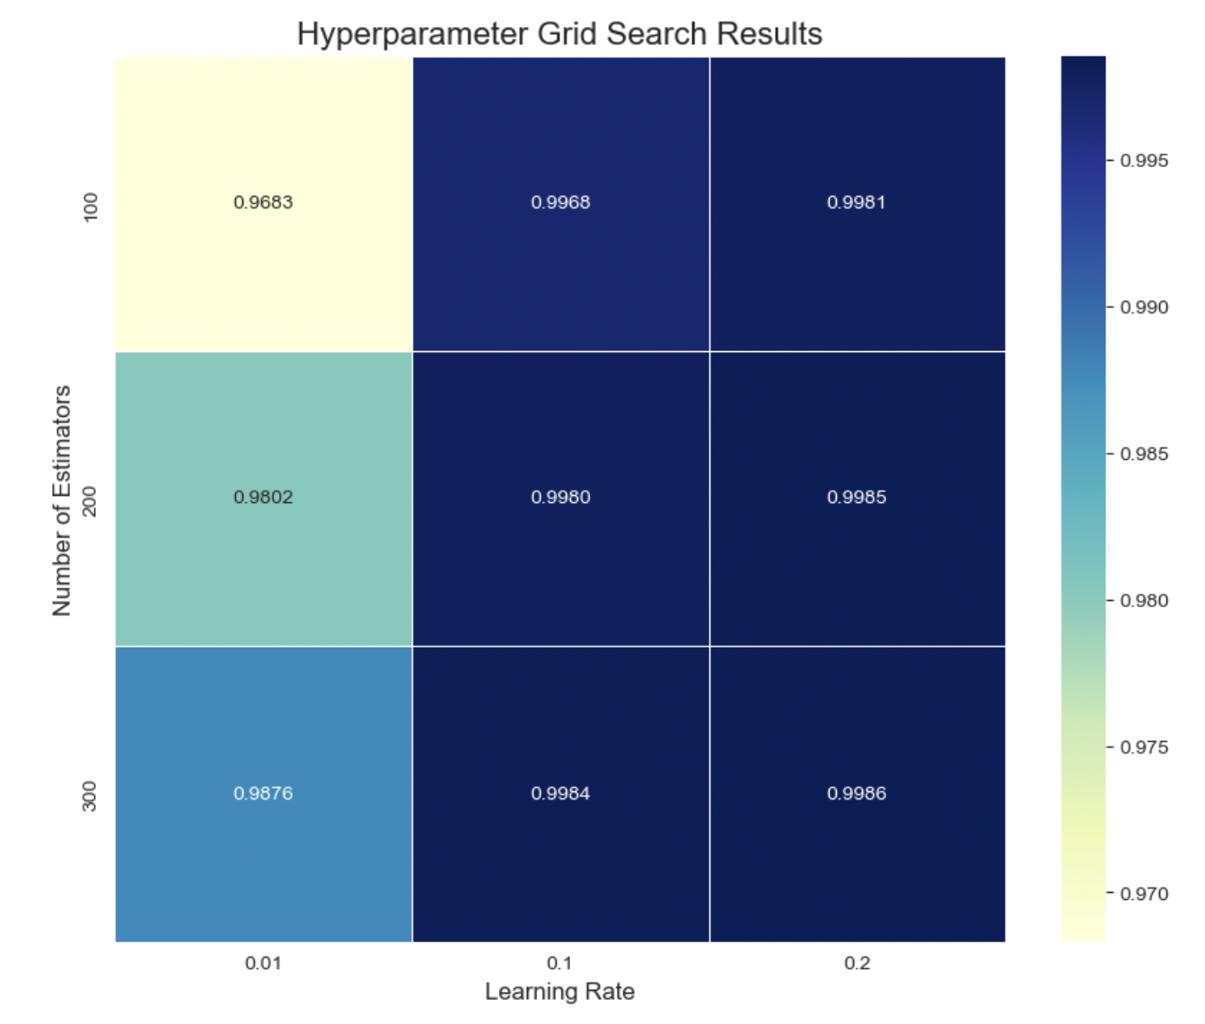
GridSearchCV with XGBoost
Outcome: Identified the best parameters for the XGBoost model:
learning_rate: 0.2
max_depth: 4
n_estimators: 300
subsample: 1.0
This process led to a more optimized model with improved performance on the test dataset.

Slide 20
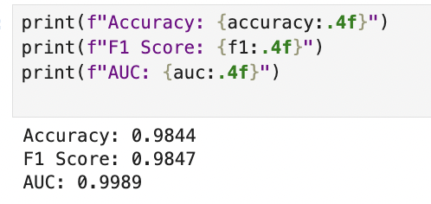
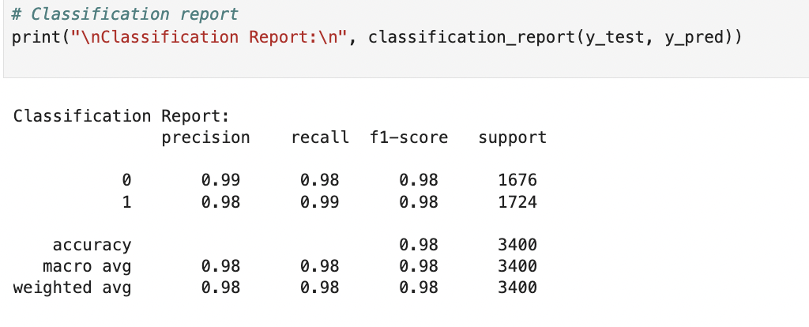
Model Results and fit
Model Performance Summary:
Accuracy: 98.44% — The model correctly predicted 98.44% of the test samples.
F1 Score: 0.9847 — Indicates a high balance between precision and recall.
AUC: 0.9989 — Excellent performance in distinguishing between classes.
Classification Report: High precision and recall for both classes, demonstrating reliable performance with minimal misclassifications.

Slide 21
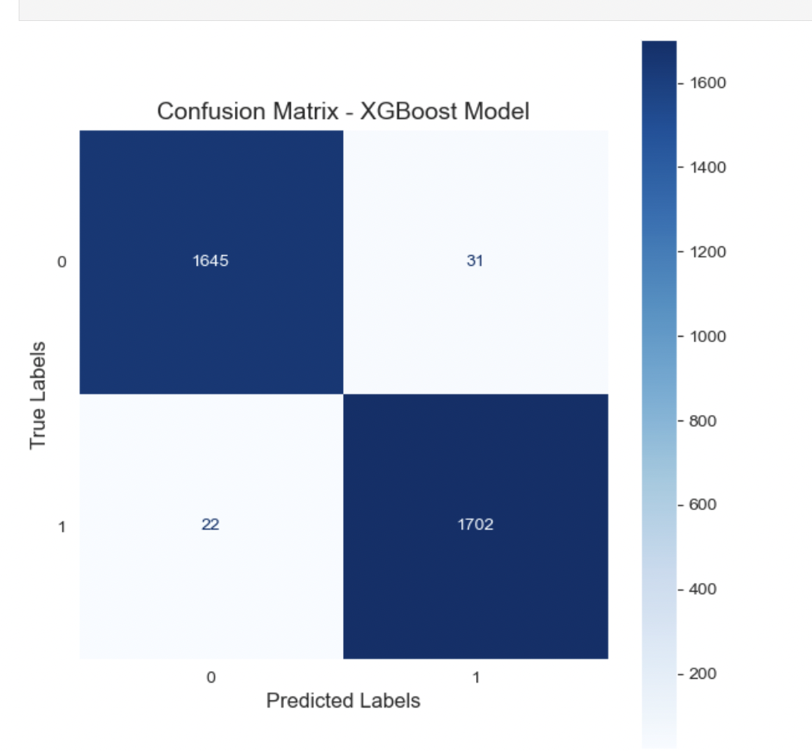
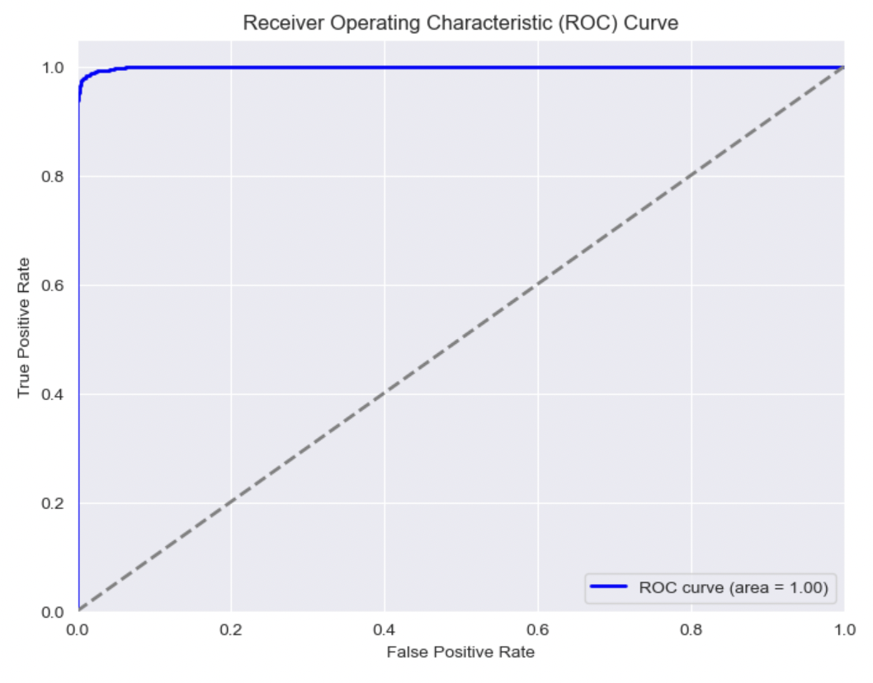
Confusion Matrix + ROC Curve

Slide 22
Conclusion
In this analysis, several models were compared to predict customer churn, with XGBoost emerging as the best-performing model. The use of GridSearchCV for hyperparameter tuning, along with the application of SMOTE and PCA, significantly improved model accuracy and generalization. Understanding the importance of features like credit score, balance, and geography provided actionable insights into customer retention strategies.
Through this project, I learned the value of balancing data with techniques like SMOTE and the impact of fine-tuning models to extract the best possible performance. Further optimization and feature engineering can continue to enhance the model's predictive power, making it a robust tool for understanding and reducing customer churn.

Slide 23
Next Steps
Model Optimization: Further tuning of hyperparameters, especially in XGBoost, could improve performance.
Additional Features: Including more customer behavioral data (e.g., transaction history, frequency of product use) could enhance the model’s ability to predict churn.
Deploying the Model: The final model could be deployed as a web application for real-time churn prediction, helping the bank take proactive measures to retain customers.
Cost-Sensitive Learning: Implementing cost-sensitive algorithms might be useful to address misclassification costs, especially since predicting false negatives (failing to identify churners) could be more costly for the bank.

Slide 24
Appendix
Python Code

